Slide 1
Brief [ briefer, briefest ]
(adjective)

Slide 2
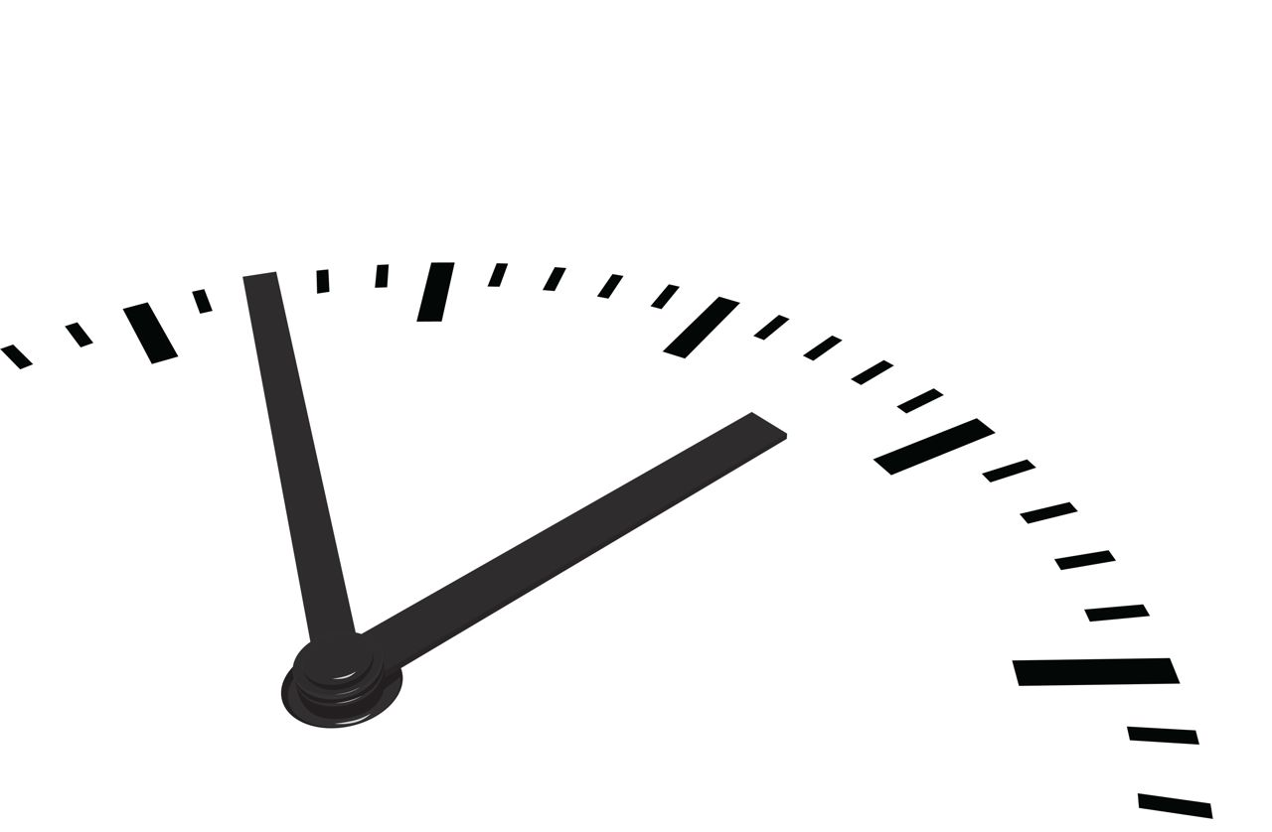
Something that is brief lasts only a short time.
Brief is another word for short.
The visit was very brief.

Slide 3
Briefly
(adverb)
Briefcase
(noun)
Briefing
(noun)

Slide 4
Briefly
She told me briefly (=kısaca) what she knew.

Slide 5

Briefcase
A briefcase is a flat case for pappers used by businessmen. (evrak çantası)

Slide 6

Briefing
A briefing is a information or instructions that you get at meeting. (bilgi)
The policemen gave a briefing about suspect before they left.

Slide 7


